Slide 1
Secure Data hiding in images using steganography
CAPSTONE PROJECT
Presented By: Amita R. Awale
Student Name : Amita R. Awale
College Name & Department : Abha Gaikwad Patil Collage of Engineering, Nagpur

Slide 2
OUTLINE
Problem Statement
Technology used
Wow factor
End users
Result
Conclusion
Git-hub Link
Future scope

Slide 3
Problem Statement
In an era of growing cyber threats, protecting sensitive data from unauthorized access is more crucial than ever. Safeguarding private messages requires a secure and discreet method for transmission. Steganography provides an effective solution by hiding secret information within images, making it invisible to the naked eye. This project uses image-based steganography with password protection, ensuring that only authorized users can decrypt and access the hidden data.

Slide 4
Technology used
Programming Language: Python (IDLE)
Libraries: openCV,cv2
Platform : Windows 11
Concept: Steganography (hiding data in an image) combined with a password-based encryption/decryption mechanism.

Slide 5
Wow factors
Invisible Encryption: Secret message hidden within the image, undetectable to the eye.
Secure Access: Only authorized users with the correct passcode can decrypt the message.
Real-time Decryption: Instant message display upon entering the correct passcode.

Slide 6
End users
Cybersecurity Professionals: Test and strengthen data hiding methods in cybersecurity.
Individuals: Securely share sensitive info like notes and passwords.
Businesses: Protect confidential data in internal communications.
Banking Sectors
Big MNC Organizations

Slide 7
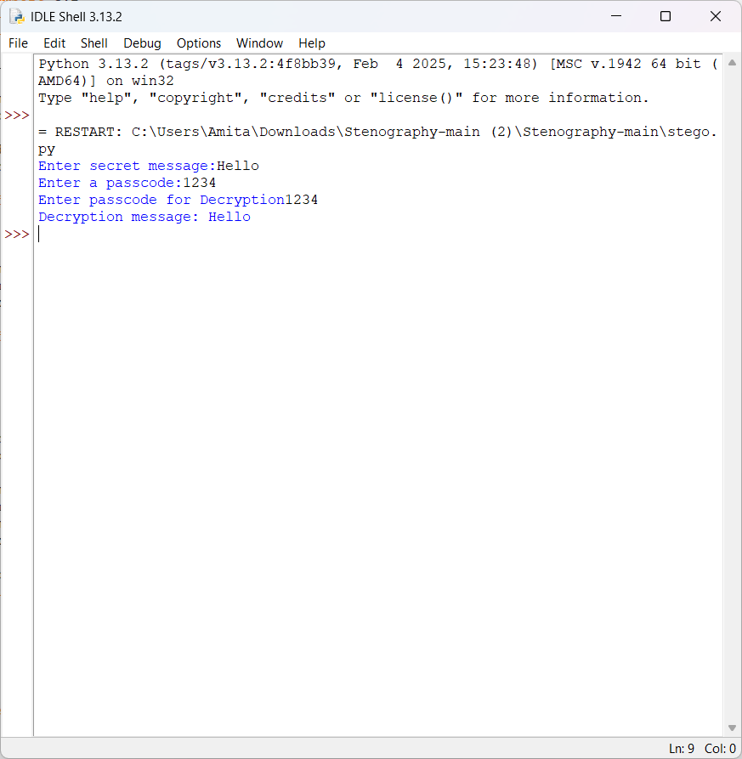
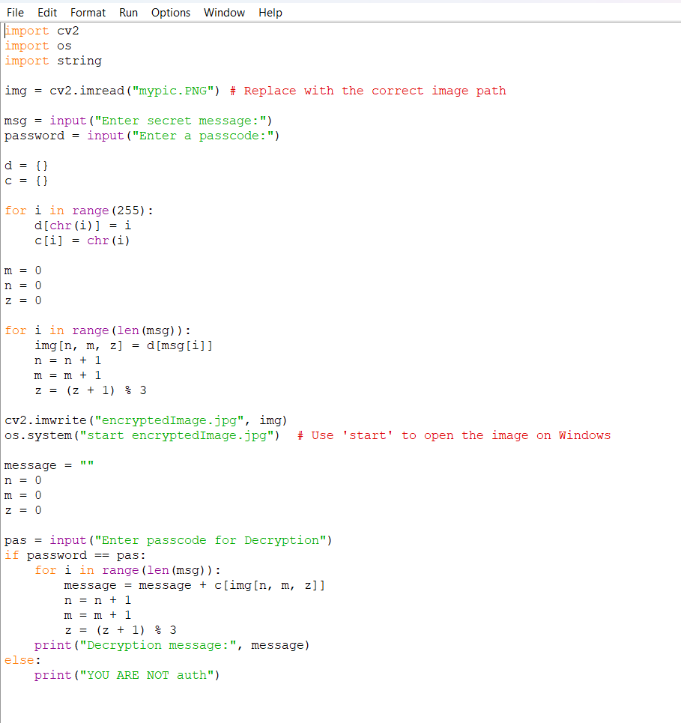
Results

Slide 8
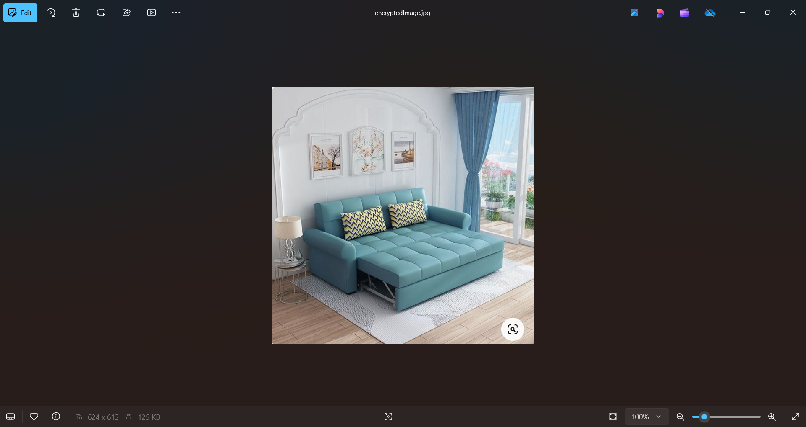
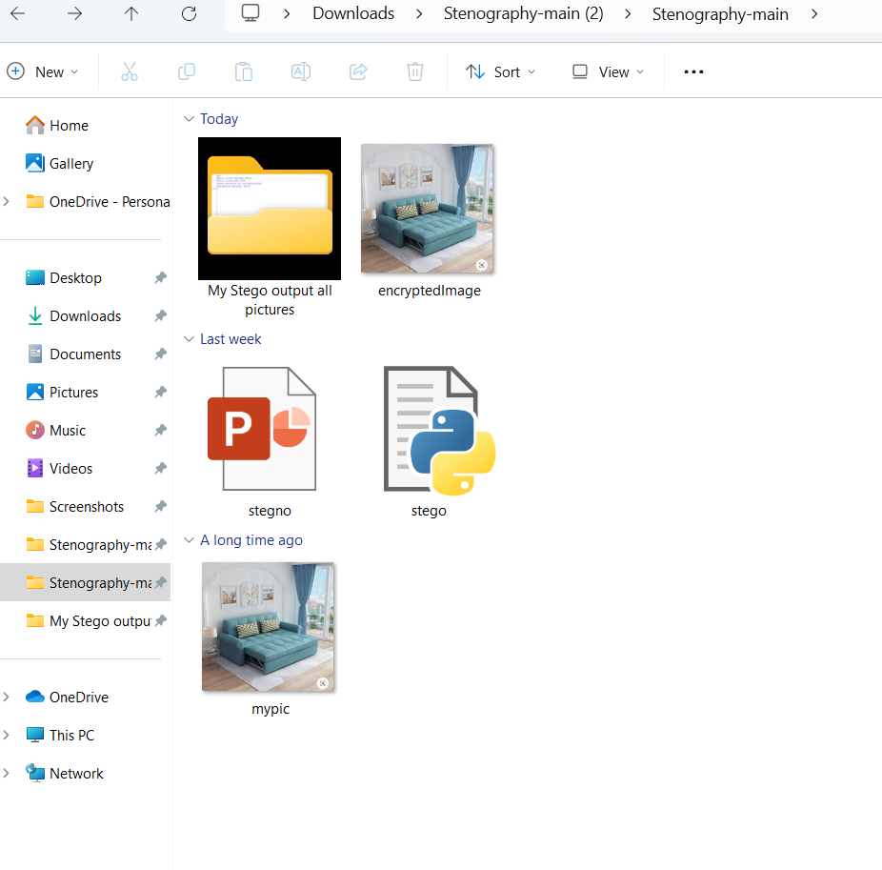
Results

Slide 9
Conclusion
The project successfully demonstrates the application of steganography to hide messages within images, ensuring data confidentiality.
Password protection adds an additional layer of security.
This method is effective for scenarios requiring private communication without detection or tampering.

Slide 10
GitHub Link
My GitHub Link is: https://github.com/AmitaAwale/My_Stego_AICTEProject.git
Repository Content :
Source Code- Stego code
Stego Code Output
Encrypted Images output
ReadMe File

Slide 11
Future scope(optional)
Mobile Application: Develop a mobile version of the app for on-the-go encrypted message sharing.
Multi-Message Embedding: Allow multiple messages to be embedded into a single image.
Advanced Encryption: Implement more robust encryption techniques like AES for added security alongside steganography.
Detection Resistance: Work on making the method more resistant to steganalysis (detection of hidden messages in images).

Slide 12
THANK YOU

